Slide 1


CRANE Database - Video Demonstration
Identifying patients with missing psychology data, at five years of age
March 2022

Slide 2
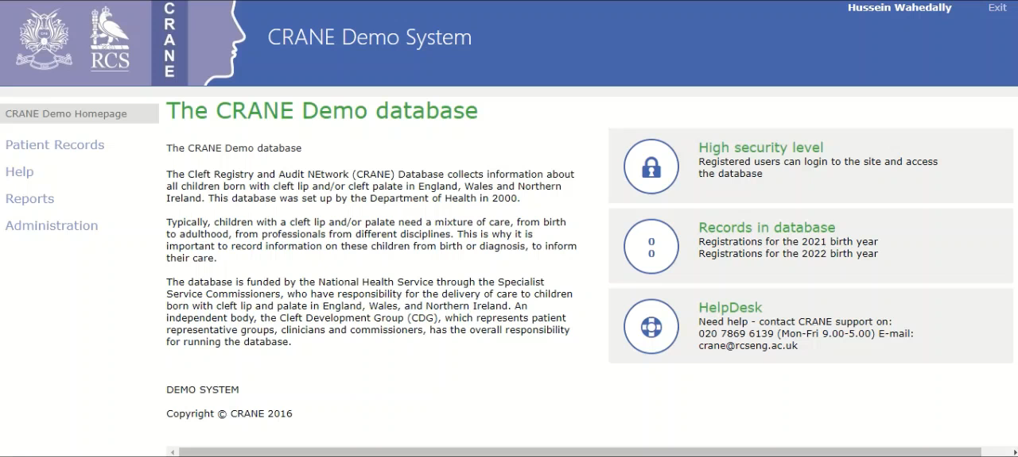

Slide 3
Resources & Guides
Accessing the CRANE Database:
https://www.crane-database.org.uk/resources/guide-quick-reference-for-accessing-the-crane-database/
Managing patient records:
https://www.crane-database.org.uk/resources/guide-quick-reference-for-managing-patient-records/
Guide for exporting data from CRANE Database:
https://www.crane-database.org.uk/resources/quick-reference-for-exporting/
Guide on Psychology outcomes data entry:
https://www.crane-database.org.uk/resources/guide-quick-reference-for-psychology-outcomes-data-entry/

Slide 4
Thank you
If you need further support please get in touch
  Email – crane@rcseng.ac.uk
  Tel – 020 7869 6139

